Slide 1
Decentralized Prediction of Social Harm Events
Zachary Spicklemire, Dorel Stoian, Archith Rammohan

Slide 2
T-CDASH Application
The application tries to predict social harm events in a specific area and time
The current version uses a Trust Service to decide if a live event report should be taken in consideration for future prediction
This is design to mitigate the effects of false reports on the machine learning prediction module
The trust service runs only one type of trust at a time
Trust Service
Accept the report
Event Report
Ignore Incident

Slide 3
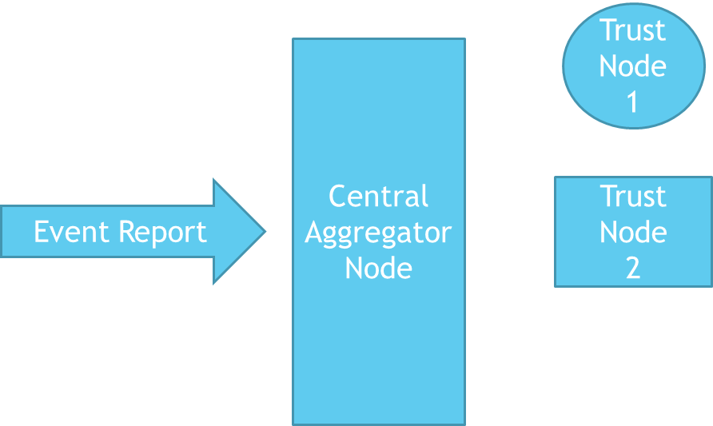
Distributed Trust Nodes
Project objective: To create a Trust Service module based on nodes that implements different trust models and collaborate to generate a common trust score
Accept the
Report
Central Aggregator
Node
Trust
Node
3
Ignore Report

Slide 4
Distributed Trust Nodes
We created three different type of trust nodes:
Differential Trusting Node
EMA Trusting Node
(Third)
These nodes process the same data entry/report and each send its decision to accept or ignore it
We have a central aggregator node that combines the data received from the nodes and takes the final decision

Slide 5
Differential Trusting Node
The idea of this type of trust is different types of events reports have different levels of trust
In the current implementation there are four levels of trust for the events:
Sure events: the rate of unreliable reports is very low and they can be all accepted
High probability events: for this category of events 85% of the reports are randomly accepted
Medium probability events: for this category of events 51% of the reports are randomly accepted
Low probability events: for this category of events 15% of the reports are randomly accepted

Slide 6
EMA Trusting Node
This is a trusting node that keeps an exponential moving average of the probabilities of different incident types.
This reacts strongly to many reports of the same incident type in a short timeframe
Scattered reports will cause the probability of trusting them to fall off

Slide 7
(Third Trusting Node)

Slide 8
Central Aggregator Node
In our current implementation the central aggregator node loads the data from a file (.csv file) and after the data it’s processed it saves it to another file (.csv file) if the decision is to accept it
Each trust node runs as an RMI server and the central node binds to each of them, in order to invoke their method that process the reports/data
To communicate between central node and trust nodes encryption was implemented to protect the data that travels over the network

Slide 9
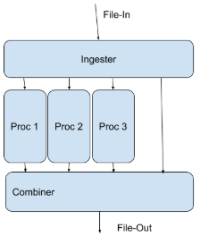
Central Aggregator Node
In order to speed up the processing time, threads are used:
One thread reads the data from the file and writes to each of the processors threads
Three processors threads are sending the data to the trusting nodes
The last threads combines the result received in order to decide if the report should be accepted or ignored
The majority vote method was implemented as a decision mechanism

Slide 10
Questions

